Slide 1
Segmenting Breast Cancer Pathological Slides
Yousef Kamil
Abdelrahman Mohamed
Mohamed Elshehaby

Slide 2
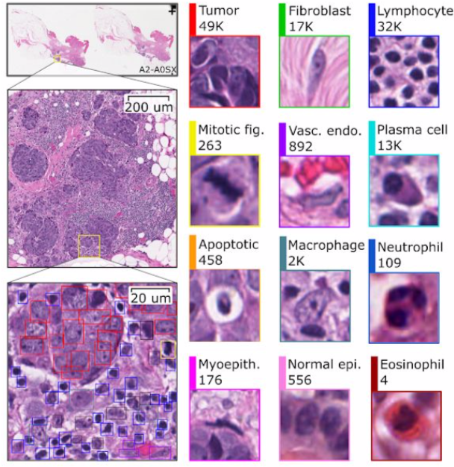
Aim of the project
Segmenting cells in sections of breast tissue biopsies to help diagnose breast cancer. Specifically a carcinomas under a type called TNBC.
Aid the pathologist in attaining better accuracies yet while consuming less time and effort.

Slide 3
Importance of project
TNBC or triple negative breast cancer shows negative results in all blood tests that should indicate cancer.
Progesterone
Estrogen
HER2 protein
The only way to diagnose this type of cancer early is through a pathologists diagnosis of the biopsies or images.
TNBC has a 5-year survival rate and is considered an aggressive type of breast cancer
Pathologists are gold standard in many diagnoses such projects should become popular the improve quality of care in medicine.
Computational pathology is booming and will soon be standardised in pathology labs
Main Stakeholders:
Payers (public and private)
Patients
Physicians

Slide 4
Description of the Data
NUCLS datasets :https://nucls.grand-challenge.org/
We worked with the single rater with 1,744 FOVs | 59,485 nuclei
“We used a web-based annotation platform called HistomicsUI for annotation, feedback, and quality review .“
“We obtained annotations from 32 NPs and 7 pathologists, located in the US, Egypt, Syria, Australia, and Maldives.“

Slide 5
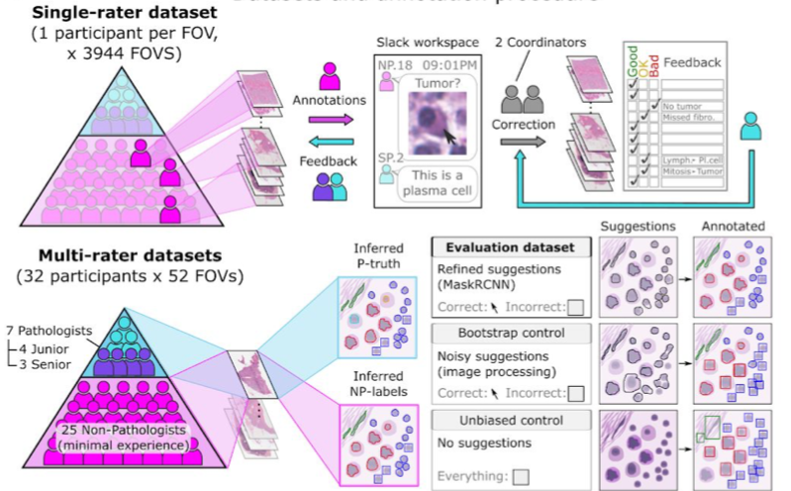
Description of the Data

Slide 6
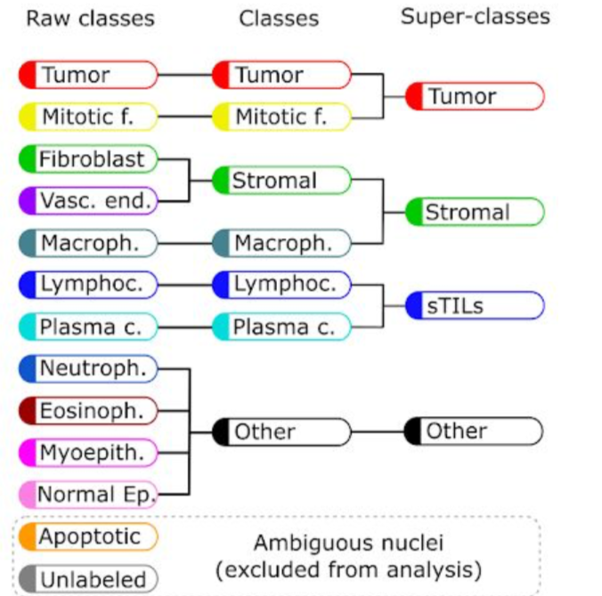
Description of the Data
NUCLS datasets :https://nucls.grand-challenge.org/

Slide 7
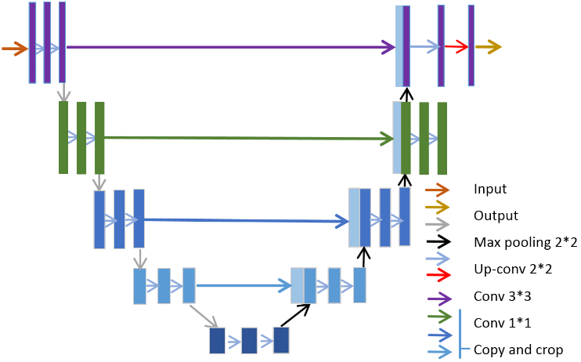
Model Architecture : UNET

Slide 8
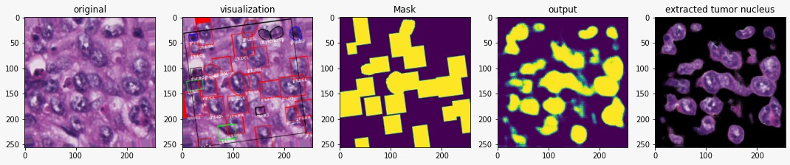
Results
Binary Accuracy on Train: 95%
Binary Accuracy on Test : 89%

Slide 9
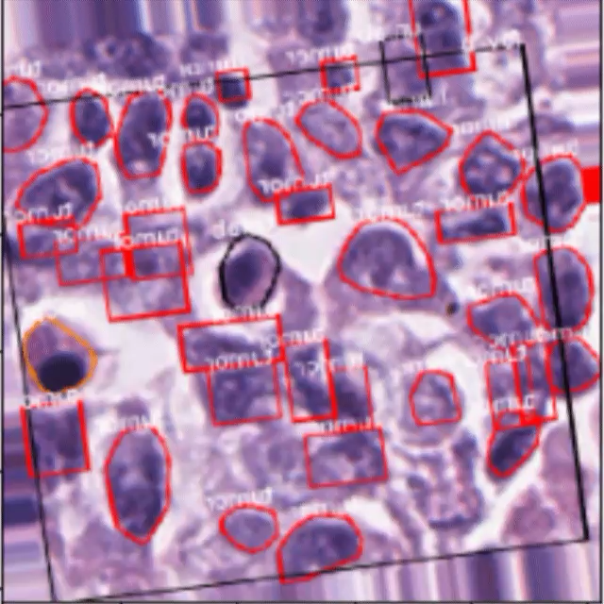
Results

Slide 10
Challenges
Data not labeled by pathologists but was largest available
No subject matter expertise
Limited computational resources
Unconventional loss function
Label masks not precise
Some labels were missed ( expert opinion)
Masks had problems in structure
TNBC has different types that might look different

Slide 11
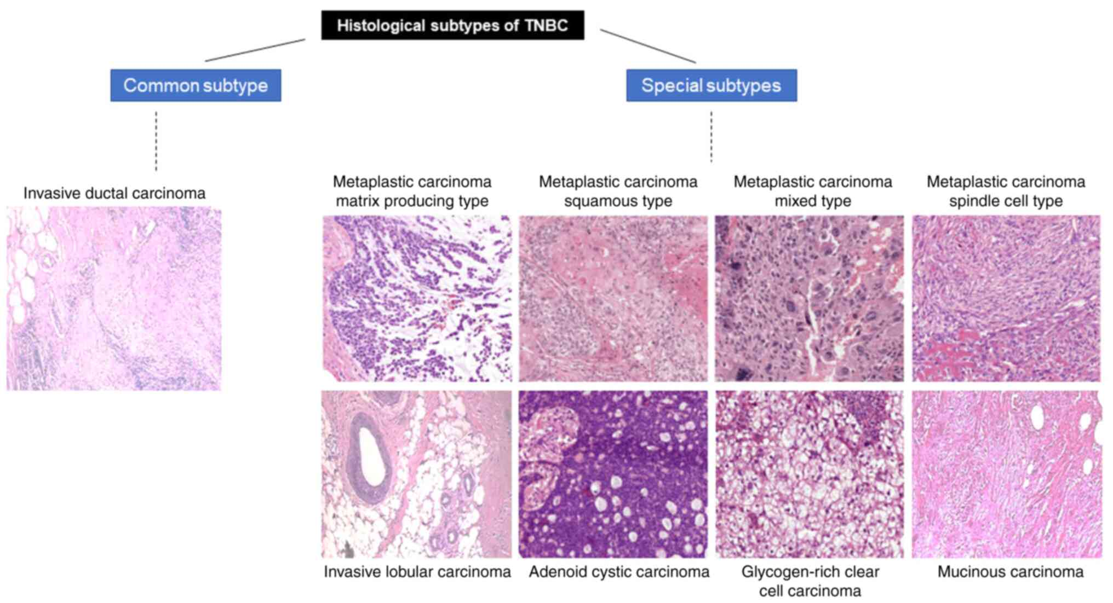
Challenges

Slide 12
References
Kos, Z., Roblin, E., Kim, R.S. et al. Pitfalls in assessing stromal tumor infiltrating lymphocytes (sTILs) in breast cancer. npj Breast Cancer 6, 17 (2020). https://doi.org/10.1038/s41523-020-0156-0
https://arxiv.org/abs/2102.09099
https://www.cancer.org/cancer/breast-cancer/about/types-of-breast-cancer/triple-negative.html#:~:text=Triple%2Dnegative%20breast%20cancer%20(TNBC,of%20the%20protein%20called%20HER2.

